Slide 1





Next Gen Employability Program
Full Stack Web Development with AI Tools
Team Details – NG_CP_Team_670
Name: Deepanshu Singh
Name: Bhumika Badhani
Name: Garima
Name: Ansh Rohilla
Name: Deepanshu Gupta
College: Inderprastha Engineering College, Ghaziabad

Slide 2

The content is curated from online/offline resources and used for educational purpose only.
Notes:
Speaker would be briefing the students that this content has been prepared for the educational purpose only and is referred from multiple sites which are cited in the last.​​
---------------------------------------------------​​
A disclaimer is a statement or notice that is intended to clarify, limit, or provide information about the scope, limitations, or potential risks associated with certain actions, information, products, services, or content. ​​
​​
​

Slide 3

Project Title
SmartCare HMS: An AI-Driven Emergency Triage and Integrated Hospital Management System
Notes:
In this slide speaker will be introducing the program and its outcomes. The speaker will introduce himself in brief

Slide 4

Table of Contents
Introduction
Objective
Problem Statement
Solution Approach
System Features
Technology Used
System Flowchart
Core Modules
Security Measures
Conclusion & Future Work
References
Notes:
This slide, The speaker will talk about the content that we will be covering in this session as follows:
Introduction
Importance of UI/UX in industry
History and Definitions of UI and UX
Key Differences between UI/UX
Use Cases
Significance in Web Development
Use Cases
Visual Design Principles
Design process
Color theory and psychology
Typography and readability
Layout and Spacing
Responsive design basics
Usability and Accessibility
Usability Aspects
Web Content Accessibility Guidelines (WCAG)
Inclusive design practices
Consistency
User Experience
User-Centered Design
User research methods
Interactive Elements and Feedback
Mini Case Study
Discussing a popular UI/UX design
Hands-On
Introduction to Figma for UI/UX design

Slide 5
Introduction
Healthcare systems today face major challenges such as inefficient patient management, long waiting times, and lack of real-time access to medical data. Most hospitals still rely on traditional and semi-manual processes, which are not effective during high patient load or emergency situations.
To address these challenges, this project presents a Health Management System, which is a web-based healthcare platform developed using Full Stack Web Development . The system is designed to digitally manage hospital operations including patient registration, appointment scheduling, and medical history management.
The proposed system focuses on improving patient–doctor interaction by providing an online, transparent, and automated environment. One of the key highlights of this project is the integration of an AI-based emergency priority mechanism, which evaluates patient symptoms and assigns priority based on medical urgency rather than booking time.
The application is built using the Django framework, ensuring high security, scalability, and reliability. By digitizing healthcare workflows and introducing intelligent decision support, this system aims to reduce waiting time, minimize human errors, and ensure faster healthcare delivery, making it suitable for modern clinics and hospitals.
Notes:
This slide, The speaker will talk about the content that we will be covering in this session as follows:
Introduction
Importance of UI/UX in industry
History and Definitions of UI and UX
Key Differences between UI/UX
Use Cases
Significance in Web Development
Use Cases
Visual Design Principles
Design process
Color theory and psychology
Typography and readability
Layout and Spacing
Responsive design basics
Usability and Accessibility
Usability Aspects
Web Content Accessibility Guidelines (WCAG)
Inclusive design practices
Consistency
User Experience
User-Centered Design
User research methods
Interactive Elements and Feedback
Mini Case Study
Discussing a popular UI/UX design
Hands-On
Introduction to Figma for UI/UX design

Slide 6
To develop a centralized web-based healthcare management platform.
To integrate system-based symptom analysis for emergency detection.
To generate an emergency score for patient prioritization.
To replace traditional First Come First Serve scheduling with urgency-based scheduling.
To ensure timely medical attention for critical patients.
To automate appointment booking and patient management processes.
To reduce manual workload and operational delays in hospitals.
To minimize human errors through automated workflows.
To provide doctors with a prioritized patient dashboard.
To maintain secure storage and quick retrieval of patient medical data.
To design a scalable system suitable for real-world hospital usage.
To improve transparency and efficiency in healthcare services.
Objective

Slide 7
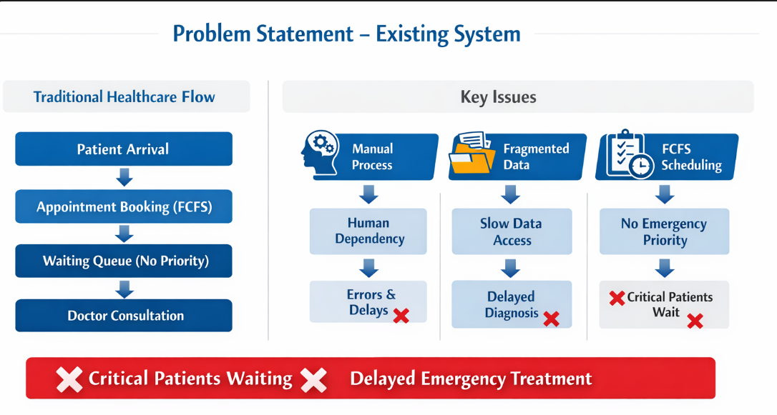
Problem Statement
Traditional FCFS systems fail during emergencies
Critical patients may wait longer than stable patients and face delays
No automated decision-making support
High dependency on manual staff coordination
Increases risk to patient health and safety
Manual coordination causes errors
Patient medical data not instantly available
Notes:
This slide, The speaker will talk about the content that we will be covering in this session as follows:
Introduction
Importance of UI/UX in industry
History and Definitions of UI and UX
Key Differences between UI/UX
Use Cases
Significance in Web Development
Use Cases
Visual Design Principles
Design process
Color theory and psychology
Typography and readability
Layout and Spacing
Responsive design basics
Usability and Accessibility
Usability Aspects
Web Content Accessibility Guidelines (WCAG)
Inclusive design practices
Consistency
User Experience
User-Centered Design
User research methods
Interactive Elements and Feedback
Mini Case Study
Discussing a popular UI/UX design
Hands-On
Introduction to Figma for UI/UX design

Slide 8
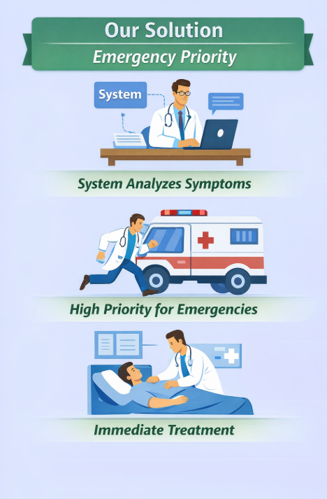
Solution Approach
AI-Based Emergency Analysis
Patients enter symptoms during appointment booking.
System analyzes symptoms using predefined medical rules and logic-based algorithms.
An Emergency Score is generated to determine condition severity.
Priority-Based Appointment Scheduling
Appointments are scheduled based on medical urgency, not FCFS.
Critical patients are automatically prioritized over stable patients.
Ensures faster medical attention during emergencies.
Automated Workflow
Reduces dependency on manual staff coordination.
Minimizes human errors and operational delays.
Doctors receive a prioritized dashboard of patients.
Secure & Scalable Web Architecture
Built using the Django framework for security and scalability.
Structured database enables quick access to patient medical history.
Designed to efficiently handle real-world hospital traffic.
Notes:
This slide, The speaker will talk about the content that we will be covering in this session as follows:
Introduction
Importance of UI/UX in industry
History and Definitions of UI and UX
Key Differences between UI/UX
Use Cases
Significance in Web Development
Use Cases
Visual Design Principles
Design process
Color theory and psychology
Typography and readability
Layout and Spacing
Responsive design basics
Usability and Accessibility
Usability Aspects
Web Content Accessibility Guidelines (WCAG)
Inclusive design practices
Consistency
User Experience
User-Centered Design
User research methods
Interactive Elements and Feedback
Mini Case Study
Discussing a popular UI/UX design
Hands-On
Introduction to Figma for UI/UX design

Slide 9
System Features
Patient Registration & Login Allows patients to create accounts, log in securely, and manage their profiles.
Doctor Registration & Login Enables doctors to register, log in, and manage their appointments and patient data.
Online Appointment Booking Patients can easily book appointments with doctors through the website.
System-Based Emergency Detection Patients enter symptoms and disease details; AI analyzes the data and assigns an emergency priority.
Priority-Based Appointment Scheduling Patients with higher emergency levels get faster appointment slots.
Home Visit Request System If patients cannot visit the hospital, they can request doctors for home visits.
Appointment Management System Doctors can view, accept, reject, or reschedule appointments.
Digital Medical Records Secure storage and management of patient medical history.

Slide 10
Technology Used
Frontend Technologies (Brief)
HTML5: Used to create the basic structure of web pages such as forms, dashboards, and layouts.
CSS3: Used for designing attractive, responsive, and user-friendly interfaces.
JavaScript: Adds interactivity, form validation, and dynamic content updates to enhance user experience.
Backend Technology (Brief)
Django (Python Framework): Used for backend development due to its high security, scalability, and rapid development features. It manages business logic, user authentication, appointment scheduling, and communication with the database.
Database Technology (Brief)
SQLite3: Relational databases used to store patient records, doctor details, appointments, and medical history. They ensure data security, integrity, and fast access to information.

Slide 11
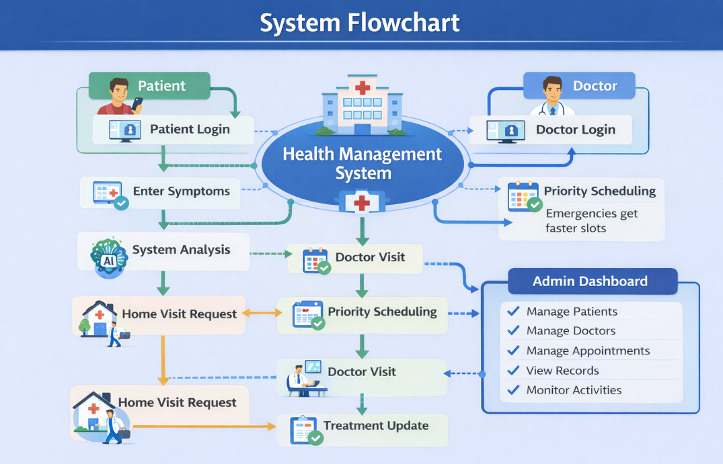
System Flowchart
The process starts with user registration and login (patient or doctor).
The patient enters personal details, symptoms, and disease information.
The system performs system analysis to evaluate the severity of the condition.
Based on analysis, the system assigns appointment priority.
The appointment is scheduled accordingly.
The doctor reviews the request and confirms the appointment or home visit.
The doctor provides treatment and updates the medical records.
Finally, the system stores all data securely in the database.

Slide 12
Core Modules
Patient Management Module
Allows patients to book appointments and request home visits
Doctor Management Module
Manages doctor profiles, availability, and appointment handling
Enables doctors to view patient details and update treatment records
Appointment Scheduling Module
Implements priority-based scheduling based on emergency level
System Analysis Module
Determines urgency level and assigns priority
Home Visit Management Module
Allows patients to request doctor home visits
Medical Records Management Module
Stores and manages patient treatment history securely
Allows doctors to update prescriptions and reports
Notification Module
Sends alerts for appointment confirmation, reminders, and updates

Slide 13
Security Measures
User Authentication & Authorization
Secure login system for patients, doctors, and admin
Role-based access control to restrict unauthorized access
Password Encryption
User passwords are securely stored using hashing algorithms
Secure Data Storage
Patient records and medical data are stored securely in the database
Input Validation & Sanitization
Prevents SQL Injection, Cross-Site Scripting (XSS), and other attacks
CSRF Protection
Django’s built-in CSRF protection to prevent cross-site request forgery
Secure Communication (HTTPS)
Ensures encrypted data transmission between client and server
Access Logging & Monitoring
Logs system activity to detect suspicious behavior
Regular Data Backup
Prevents data loss in case of system failure

Slide 14
Conclusion and Future work
Conclusion
Provides a smart and efficient healthcare management platform
Enables priority-based treatment instead of first-come-first-serve
Supports online appointments and home visit services
Ensures faster treatment for emergency patients
Improves healthcare accessibility, efficiency, and service quality
Future Work
Video consultation feature
Mobile application development
Online medicine home delivery integration
Wearable device health monitoring
Advanced AI-based emergency prediction
Cloud-based deployment
Integrating Natural Language Processing (NLP) model to analyze patient symptom descriptions and automatically assign a priority score without human intervention.

Slide 15
Rreferences
https://docs.djangoproject.com/en/6.0/
https://getbootstrap.com/docs/5.3/getting-started/introduction/
https://docs.python.org/3/
https://www.sqlite.org/docs.html
https://www.ahrq.gov/patient-safety/settings/hospital/esi.html
Notes:
This slide, The speaker will talk about the content that we will be covering in this session as follows:
Introduction
Importance of UI/UX in industry
History and Definitions of UI and UX
Key Differences between UI/UX
Use Cases
Significance in Web Development
Use Cases
Visual Design Principles
Design process
Color theory and psychology
Typography and readability
Layout and Spacing
Responsive design basics
Usability and Accessibility
Usability Aspects
Web Content Accessibility Guidelines (WCAG)
Inclusive design practices
Consistency
User Experience
User-Centered Design
User research methods
Interactive Elements and Feedback
Mini Case Study
Discussing a popular UI/UX design
Hands-On
Introduction to Figma for UI/UX design

